Slide 1

Bug Tracking and Source Control Systems
Performing Tests and Reporting Issues
QA
Fundamentals
SoftUni Team
Technical Trainers
Software University
http://softuni.bg

Slide 2
Table of Content
Performing a Test
Bug Tracking Systems
JIRA
GitHub Issues
Reporting Issues

Slide 3

Performing a Test

Slide 4

Performing a Test
Usually a certain feature or a bugfix is tested
One draws testing steps
Should find
The intentional behavior
The unexpected behavior

Slide 5
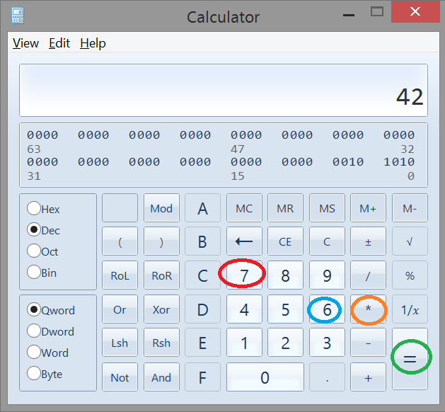
Performing a Test (2)

Slide 6

Now What?

Slide 7

What Are Incidents?
Notes:
Book: Foundations of Software Testing ISTQB Certification - 5.6 INCIDENT MANAGEMENT

Slide 8
What Else Could Cause an Incident?
Notes:
Book: Foundations of Software Testing ISTQB Certification - 5.6 INCIDENT MANAGEMENT

Slide 9

What Do We Report Defects Against?
Notes:
Book: Foundations of Software Testing ISTQB Certification - 5.6 INCIDENT MANAGEMENT

Slide 10

Bug Tracking Systems

Slide 11

Bug Tracking Systems
What is a bug tracking system?
A bug tracking system or defect tracking system is a software application that keeps track of reported software bugs in software development projects. It may be regarded as a type of issue tracking system.

Slide 12

What Goes in an Incident Report?
Notes:
Book: Foundations of Software Testing ISTQB Certification - 5.6 INCIDENT MANAGEMENT

Slide 13
What Goes in an Incident Report?
Notes:
Book: Foundations of Software Testing ISTQB Certification - 5.6 INCIDENT MANAGEMENT

Slide 14
What Goes in an Incident Report?
Notes:
Book: Foundations of Software Testing ISTQB Certification - 5.6 INCIDENT MANAGEMENT

Slide 15
What Goes in an Incident Report?
Notes:
Book: Foundations of Software Testing ISTQB Certification - 5.6 INCIDENT MANAGEMENT

Slide 16
What Goes in an Incident Report?
Notes:
Book: Foundations of Software Testing ISTQB Certification - 5.6 INCIDENT MANAGEMENT

Slide 17

Defect Severity
Notes:
Book: Foundations of Software Testing ISTQB Certification - 5.6 INCIDENT MANAGEMENT

Slide 18
Defect Severity Levels
Notes:
Book: Foundations of Software Testing ISTQB Certification - 5.6 INCIDENT MANAGEMENT

Slide 19
Defect Severity Levels
Notes:
Book: Foundations of Software Testing ISTQB Certification - 5.6 INCIDENT MANAGEMENT

Slide 20
Defect Severity Levels (3)
Notes:
Book: Foundations of Software Testing ISTQB Certification - 5.6 INCIDENT MANAGEMENT

Slide 21

Defect Priority
Notes:
Book: Foundations of Software Testing ISTQB Certification - 5.6 INCIDENT MANAGEMENT

Slide 22
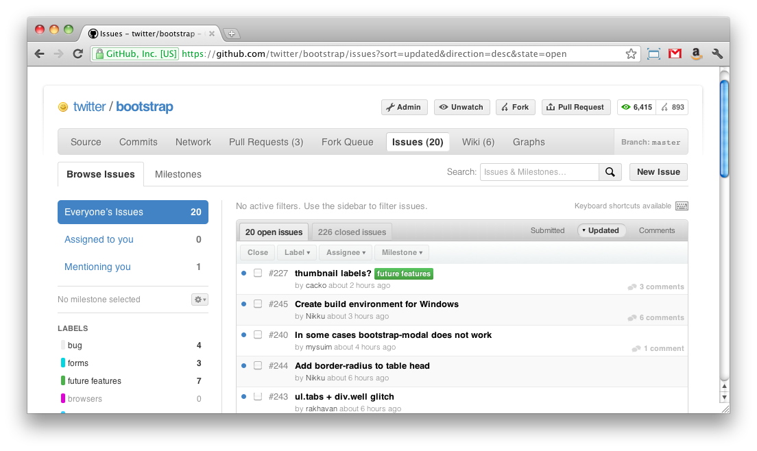
GitHub Issues – Live Demo

Slide 23
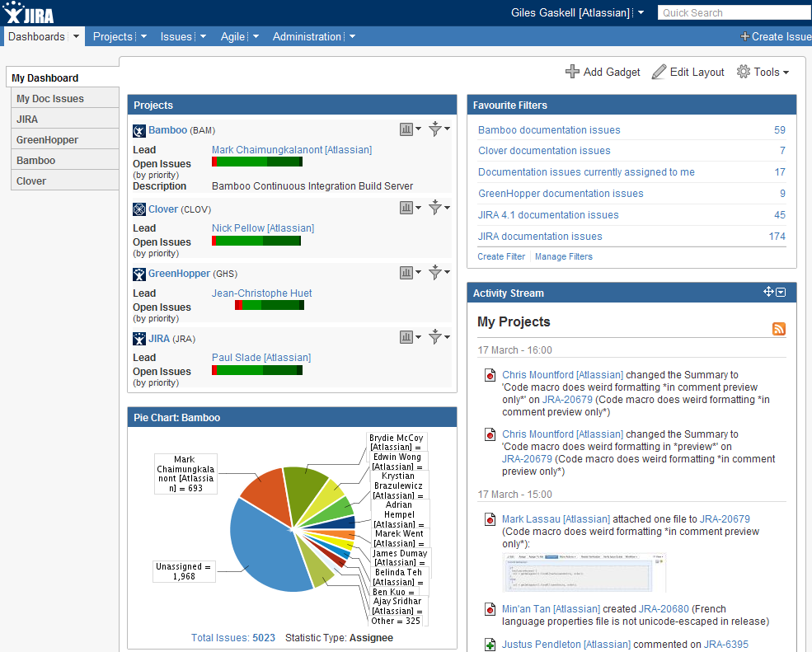
JIRA – Live Demo

Slide 24

Defect Lifecycle

Slide 25
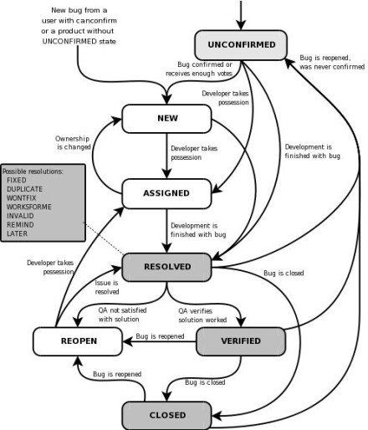
Defect Lifecycle
Notes:
Book: Foundations of Software Testing ISTQB Certification - 5.6 INCIDENT MANAGEMENT

Slide 26
Defect Lifecycle States
Notes:
Book: Foundations of Software Testing ISTQB Certification - 5.6 INCIDENT MANAGEMENT

Slide 27
Defect Lifecycle States
Notes:
Book: Foundations of Software Testing ISTQB Certification - 5.6 INCIDENT MANAGEMENT

Slide 28

Defect Lifecycle States
Notes:
Book: Foundations of Software Testing ISTQB Certification - 5.6 INCIDENT MANAGEMENT

Slide 29

Defect Lifecycle States
Notes:
Book: Foundations of Software Testing ISTQB Certification - 5.6 INCIDENT MANAGEMENT

Slide 30
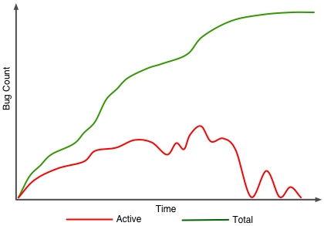
Defect Management Metrics
Notes:
Book: Foundations of Software Testing ISTQB Certification - 5.6 INCIDENT MANAGEMENT

Slide 31

Defect Management Metrics
Notes:
Book: Foundations of Software Testing ISTQB Certification - 5.6 INCIDENT MANAGEMENT

Slide 32

Defect Management Metrics
Notes:
Book: Foundations of Software Testing ISTQB Certification - 5.6 INCIDENT MANAGEMENT

Slide 33
Golden Rules for Bug Reporting
Notes:
Book: Foundations of Software Testing ISTQB Certification - 5.6 INCIDENT MANAGEMENT

Slide 34
Golden Rules for Bug Reporting
Notes:
Book: Foundations of Software Testing ISTQB Certification - 5.6 INCIDENT MANAGEMENT

Slide 35
Golden Rules for Bug Reporting
Notes:
Book: Foundations of Software Testing ISTQB Certification - 5.6 INCIDENT MANAGEMENT

Slide 36

Do Not Report Such Bugs

Slide 37
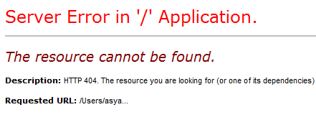

Bad Bug Report Example
Vague ones which just report the symptom
"I just clicked and it crashes"
Notes:
Results from the course?

Slide 38


Bad Bug Report Example (2)
Ones which just use adjectives instead of numbers
"System is really slow"
Notes:
Results from the course?

Slide 39


Bad Bug Report Example(3)
Lack of legacy behavioral, baseline comparisons etc.
"it used to work ..."
"system is slower ( than???)"
Notes:
Results from the course?

Slide 40

Bad Bug Report Example (4)
Bugs in which there is no effort to zero in on the root cause. No effort on removing the variables
Notes:
Results from the course?

Slide 41

Bad Bug Report Example (5)
Bugs which do not mention the user impact, yes includes too techie bugs :)
"we are using uninitialized variables here… here… and here…"
Notes:
Results from the course?

Slide 42


Bad Bug Report Example (6)
Bugs with poor reproducibility information
"happens sometimes"
Notes:
Results from the course?

Slide 43


Bad Bug Report Example (7)
Bugs which just report the problems (and not the steps to reproduce or the manifestation/symptoms of the problems)
"feature send mail is broken"
Notes:
Results from the course?

Slide 44


Bad Bug Report Example (8)
The usual deficient in information ones e.g. with no logs, no customer data info, no platform info, no SW/HW info etc.
Notes:
Results from the course?

Slide 45


Bad Bug Report Example (9)
The "Best One"
Notes:
Results from the course?

Slide 46
Bad Bug Report Example (10)
Description:
Error message is stupid.
Notes:
Results from the course?

Slide 47

Bad Bug Report Example (11)
Expected result:
Error message is less stupid.
Notes:
Results from the course?

Slide 48


Key points for good bug report
Clear and succinct title
Bad: Browser crashed
Good: Error 404: Page not found when clicking the Export button
Notes:
Results from the course?

Slide 49

Key points for good bug report (2)
Is it Reproducible?
Bad: Leave it blank
Good: "Every time", "Occasionally", "Unable to Reproduce"
Notes:
Results from the course?

Slide 50


Key points for good bug report (3)
Description
Summary – short overview
What happened – step by step
Notes:
Results from the course?

Slide 51
Key points for good bug report (4)
Supporting information?
Bad: Leave it blank
Good: "This error happens for all event records that are fees, but works for event records that are campaigns"
Notes:
Results from the course?

Slide 52

Key points for good bug report (5)
Actual results?
Bad: "It did not work"
Good: "Error 404: Access denied"
Notes:
Results from the course?

Slide 53

Key points for good bug report (6)
Expected results?
Bad: "I expected it to work"
Good: "I expected to see a popup after clicking the Run button"
Notes:
Results from the course?

Slide 54

Key points for good bug report (7)
Platform
Bad: "Windows"
Good: "Windows 7, Google Chrome 20.0.1132.47m"
Notes:
Results from the course?

Slide 55


Key points for good bug report (8)
Include the Screenshots/Attachments!!!
Notes:
Results from the course?

Slide 56
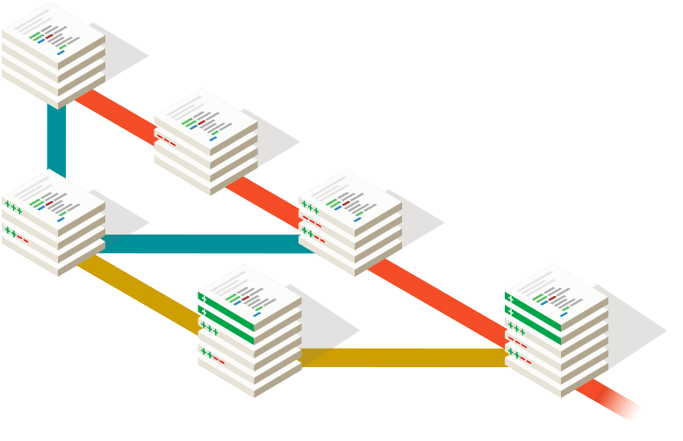
Source Control Systems
Managing Different Versions of the Same File / Document

Slide 57
Table of Contents
Version Control Systems: Philosophy
Versioning Models
Centralized Version Control
Distributed Version Control
Git – Demo + Exercise
Project Hosting Sites
GitHub – Demo

Slide 58

Version Control Systems (VCS)
Functionality
File versions control
Merge and differences search
Branching
Console and IDE plugins
Well known products
CVS, Subversion (SVN) – free, open source
Git, Mercurial – distributed, free, open source
Microsoft TFS – commercial

Slide 59
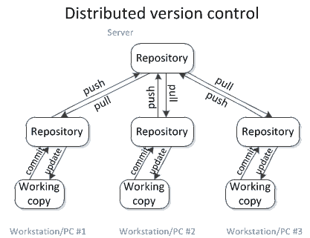
Distributed Version Control
Source: http://homes.cs.washington.edu/~mernst/advice/version-control.html

Slide 60
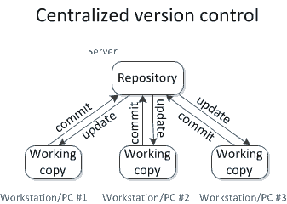
Centralized Version Control
Source: http://homes.cs.washington.edu/~mernst/advice/version-control.html

Slide 61

Merging Problems
When a file is concurrently modified, changes should be merged
Merging is hard!
It is not always automatic process
Coordination and responsibility between the developers is required
Commit changes as early as finished
Do not commit code that does not compile or blocks the work of the others
Leave meaningful comments at each commit

Slide 62
The "Distributed Version Control"
Versioning Model

Slide 63

Working with Git

Slide 64




Distributed Version Control (1)
Andy and Bobby clone the remote repository locally.
They both have the same files in
their local repositories.
Remote Repository (Server)
A
Clone
Clone
Bobby
Andy
A
A
Local Repository
(Andy)
Local Repository
(Bobby)

Slide 65
Distributed Version Control (2)
Andy and Bobby work locally
on a certain file A.
Remote Repository (Server)
A
(Local Edit)
(Local Edit)
Bobby
Andy
Bobby
Andy
Andy
Bobby
Local Repository
(Andy)
Local Repository
(Bobby)

Slide 66
Distributed Version Control (3)
Andy and Bobby commit locally the
modified file A into
their local repositories.
Remote Repository (Server)
A
Commit (locally)
Commit (locally)
Andy
Andy
Bobby
Bobby
Local Repository
(Andy)
Local Repository
(Bobby)
Andy
Bobby

Slide 67
Distributed Version Control (4)
Andy pushes the file A to the remote repository.
Still no conflicts occur.
Remote Repository (Server)
Andy
Push
Bobby
Andy
Bobby
Andy
Andy
Bobby
Local Repository
(Andy)
Local Repository
(Bobby)

Slide 68
Distributed Version Control (5)
Bobby tries to push her
changes.
A versioning conflict
occurs.
Remote Repository (Server)
Andy
Push (conflict)
Andy
Andy
Bobby
Bobby
Local Repository
(Andy)
Local Repository
(Bobby)
Andy
Bobby
68

Slide 69
Distributed Version Control (6)
Bobby merges the her
local files with the files
from the remote
repository.
Conflicts are locally resolved.
Remote Repository (Server)
Andy
Pull (Fetch + Merge)
Andy
Andy
Bobby
+Andy
Bobby
+Andy
Local Repository
(Andy)
Local Repository
(Bobby)
Andy
Bobby
69

Slide 70
Distributed Version Control (7)
Bobby commits her
merged changes.
No version conflict
Remote Repository (Server)
Bobby
+Andy
Push (No conflict)
Andy
Andy
Bobby
+Andy
Bobby
+Andy
Local Repository
(Andy)
Local Repository
(Bobby)
Andy
Bobby
70

Slide 71
Distributed Version Control (8)
Andy pulls (updates) the
changed files from
the remote repository.
Remote Repository (Server)
Bobby
+Andy
Pull
Bobby
+Andy
Bobby
+Andy
Bobby
+Andy
Bobby
+Andy
Local Repository
(Andy)
Local Repository
(Bobby)
Andy
Bobby
71

Slide 72
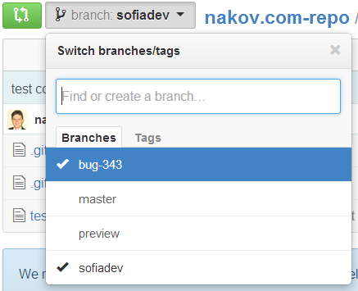
Branching
Branching allows splitting the development line into separate branches
Different developers work in different branches
Branching is suitable for:
Development of new feature or fix in a new version of the product (for example version 2.0)
Features are invisible in the main development line
Until merged with it
You can still make changes in the older version (for example version 1.0.1)

Slide 73

Branching – Example
DE 2.1
Branch ->
DE
DE 2.0
Branch ->
EN
EN 2.0
EN 3.0
EN 4.0
Main trunk
(remote master)
File A
Branch 1.2.4. ->
FR
FR 2.0
FR 3.0

Slide 74

Project Hosting and Team Collaboration Sites
GitHub, SourceForge, Google Code, CodePlex, Project Locker

Slide 75
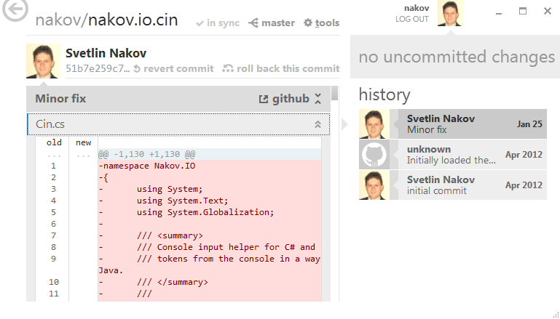
Project Hosting Sites
GitHub – https://github.com
The #1 project hosting site in the world
Free for open-source projects
Paid plans for private projects
GitHub provides own Windows client
GitHub for Windows
http://windows.github.com
Dramatically simplifies Git
For beginners only

Slide 76
Project Hosting Sites
Bitbucket – http://bitbucket.org
Source control (Mercurial), issue tracker, wiki, management tools
Private projects, free and paid editions
Others: Unfuddle, XP-Dev, Beanstalk
SourceForge – http://www.sourceforge.net
Source control (SVN, Git, …), web hosting, tracker, wiki, blog, mailing lists, file release, statistics, etc.
Free, all projects are public and open source

Slide 77

Summary
Project Management Systems
What is an issue tracker?
JIRA
GitHub Issues
How to report an issue?
What is a Source Control System?
Git
SVN
…
…
…

Slide 79






Diamond Partners

Slide 80






Diamond Partners

Slide 81





Trainings @ Software University (SoftUni)
Software University – High-Quality Education, Profession and Job for Software Developers
softuni.bg
Software University Foundation
http://softuni.foundation/
Software University @ Facebook
facebook.com/SoftwareUniversity
Software University Forums
forum.softuni.bg

Slide 82

License
This course (slides, examples, demos, videos, homework, etc.) is licensed under the "Creative Commons Attribution-NonCommercial-ShareAlike 4.0 International" license

